Slide 1

ILO/CINTERFOR
Inter-American Centre for Knowledge Development in Vocational Training
20 October, 2023

Slide 2
A Network of Technical Assistance & Horizontal Cooperation
60+ TVET institutions
28 countries
Opportunities to 15 million participants/year

Slide 3
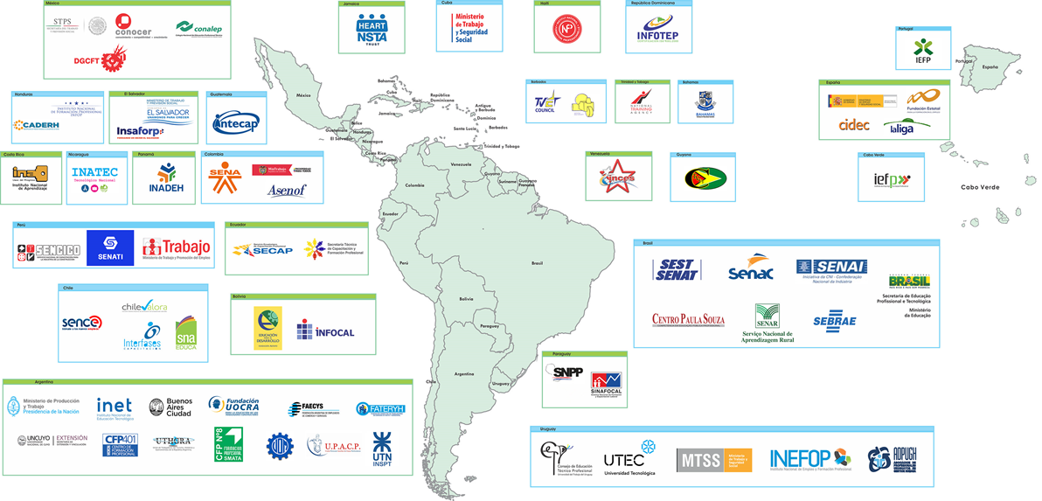
ILO/Cinterfor Network

Slide 4


A Renewed Era of Transformations and Network of Alliances
Regional requirements for: Skilling, Reskilling, Up-Skilling
Transformations:
- Technological
- Sustainable economies and societies
- Demographic
Technical assistance
Collaborative Innovation Projects (CIPs)
Digital Services Unit
Quality online courses (tutoring + capstone project, tripartite/country teams)
Webinars, Video-Conferences, Co-Creation, Collaborative Projects

Slide 5
Skills Forecasting
Technical assistance and training
Since 2012 ILO/Cinterfor has supported the development of mechanisms to anticipate skills needs. It covers mostly SENAI´s (the industrial NTA in Brazil) prospective model but also SENA (Colombia), SENCE (Chile) and SKILLS Dept. (in HQ) methodologies
Cooperation and knowledge management
More than 78 technicians from 22 countries have been trained.
New offer– learning, practice, capabilities
Coordinating a Collaborative Innovation Project (CIP) on Skills Forecasting for a Green Transition (Chile, Dominican Republic, Uruguay).
More than 50 prospective studies in its website (database on prospective studies)
Using Big Data to accelerate forecasting methodologies.

Slide 6
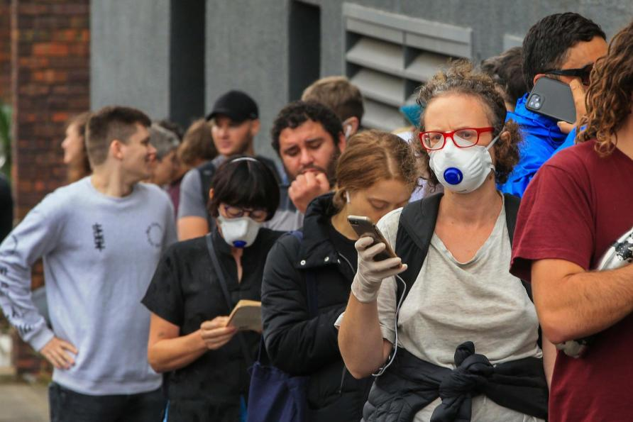
Youth employment – SWT - Apprenticeships
Youth unemployment and decent work deficits are a structural feature of labour markets in most Latin American and Caribbean countries, exacerbated by Covid-19 pandemic.
ILO Recommendation 208 (#203) on Quality Apprenticeships
- Promoting Apprenticeships and dual training in the LAC region.
- Regional Alliance on QA + Technical Secretariat
ILO/Cinterfor’s strategic goals:
  To assist countries in setting up and strengthening their QA programmes
  Policy advice on QA
Research on regulatory frameworks (with GAN)
Employers’ engagements (EuroSocial and BIBB) on employers engament in QA)
Capacity development for tripartite constituents and TVET institutions.

Slide 7

Digital Skills & Transformation, Pedagogies, Regional Research
Initiative on the impact of digitalization in the organization of work and its effect in the demand for digital skills in Latin America and the Caribbean.
* Regional Initiative
A framework and toolkit for assessing and guiding digital transformation of TVET institutions.
Technical cooperation and capacity building on methods and pedagogy innovation for the development of skills for the digital economy.

Slide 8
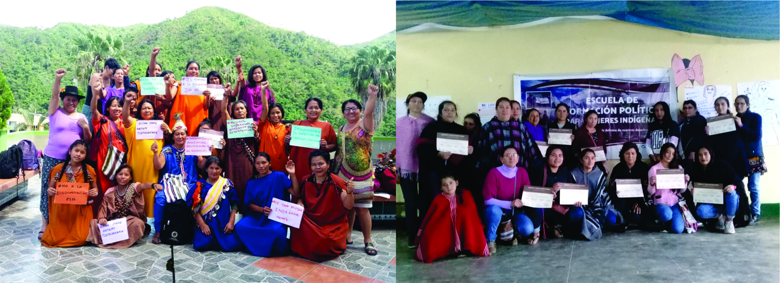

Gender Equity in TVET
Cinterfor has been promoting a gender equity approach in all training activities
2023-2024
2021
Care economy
Certification of skills
STEAM and gender
Capacity building on gender equity strategies through the development of STEAMS skills –
SST cooperation.
Online course: national teams on a practical approach.
(SST-PARDEV)
2008-2012
PGdeC
Quality and equity in vocational training and its contributions for decent work
USD $ 595.000 (SDC – COSUDE)
1998-2004
Regional Programme Formujer
(Costa Rica, Bolivia, Argentina)
US$ 5.6 millones (IADB/FOMIN)

Slide 9


Skills for a Green Transition
Uruguay PAGE Partner Country since 2018: ILO/Cinterfor focal point.
Activities including:
              Sustainable program for young entrepreneurs
              Capacity building for rural women
              People with disabilities
              Policy inputs for a transitional policy for a greener economy
Designed action research project about the state of progress in our region: 5 countries that are advancing in just transition policies.
              To identify: strategies, training offers, challenges
              A network building strategy promoting SST cooperation

Slide 10
Thank You!

